Slide 1
Linear Algebra Review

Slide 2
Literature
Shirley et al. Chapter 2 (especially 2.4)
Shirley et al. Chapter 5 (especially 5.2)
Hearn and Baker. Appendix A: Mathematics for Computer Graphics.
G.Farin, D.Hansford. “Practical Linear Algebra: A Geometry Toolbox.” 2004
R.Jagnow. “Linear Algebra Review.” 2004.

Slide 3
Overview
Points and Lines
Vectors
Inner (Dot) Products
Cross Products
Orthonormal Basis
Change of Orthonormal Basis
Matrices and Operations

Slide 4






Points and Vectors
Points specify locations in space (or in the plane)
Vectors have a magnitude and direction
v
θ

Slide 5
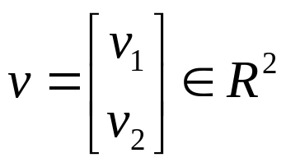
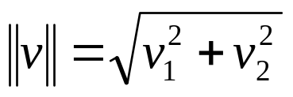
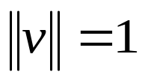
Vectors
Vector
v
Magnitude or
Length
Unit Vector or
Normalized Vector

Slide 6
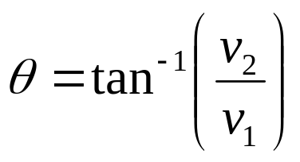
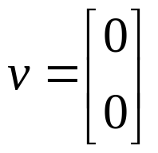
Vectors
Vector
Orientation
Zero Vector

Slide 7
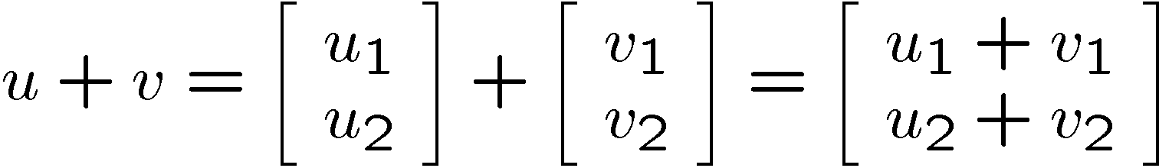
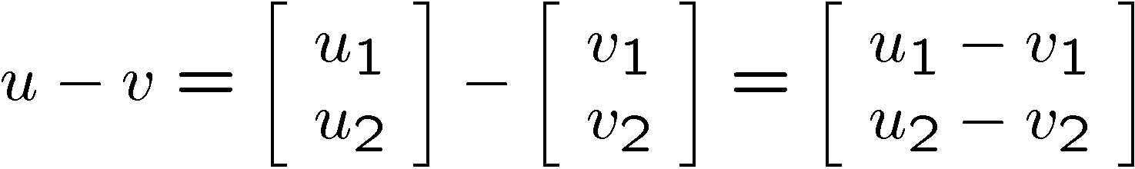
Vector Addition and Subtraction
u+v
v
u
u-v
u
demo
v

Slide 8
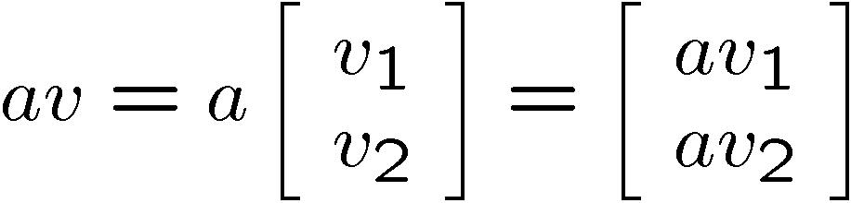
Multiplication with a Scalar
av
v

Slide 9
Point or Vector ??
Point + Vector = ?
Vector + Vector = ?
Point – Point = ?
Point + Point = ?

Slide 10
Point or Vector
Point + Vector = Point
Vector + Vector = Vector
Point - Point = Vector
u
u
u-v
v-u
v
v
Point + Point = Not Defined

Slide 11

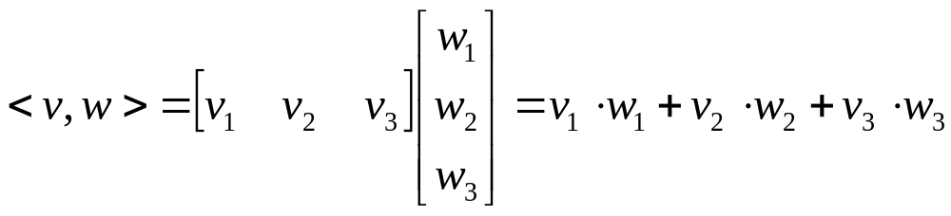
Dot Product
The dot product or inner product measures to what degree two vectors are aligned
Notation:
Computation:

Slide 12
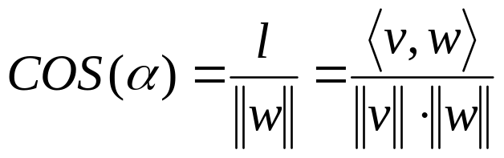
Dot Product
Geometric Interpretation:
w
α
v
l
demo

Slide 13

Dot Product Calculation
Two vectors v and w are perpendicular or normal iff

Slide 14
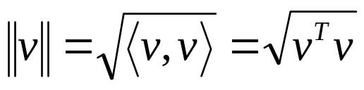
Dot Product Calculation
Note:
Length = Magnitude = 2-Norm = Euclidian Norm

Slide 15

Dot Product Laws
Commutative law:
Distributive law:

Slide 16


Cross Product
Cross Product
Notation:
The cross product is a vector!
Magnitude of u: proportional to the sine of the angle between v and w
u is perpendicular to v and w
The direction of u follows the right hand rule
u
w
α
v
demo

Slide 17
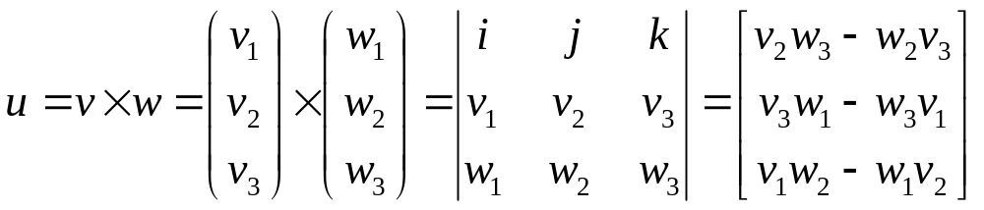
Cross Product Computation
Computation:

Slide 18



Cross Product Laws
Distributive law:
Commutative law:
Associative law:

Slide 19
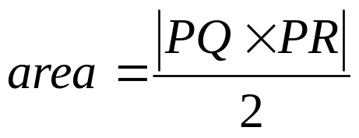
Cross Product and Triangle Area
The cross product is related to the area of a triangle
Q
R
P

Slide 20
Triangle Area Example
Given a Triangle with
P(2,3,-1), Q(-1,2,3) and R(3,1,-2)
What is the area?
Q
R
P

Slide 21
2D Lines

Slide 22
Defining a Line
Two elements of 2D geometry define a line
  two points
  a point and a vector parallel to the line
  a point and a vector perpendicular to the line
Three different mathematical representations
  parametric equation
  implicit equation
  explicit equation

Slide 23


Parametric Equation of a Line
Parametric Line Equation:
(Note t is a scalar )
v

Slide 24
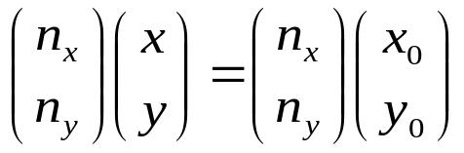
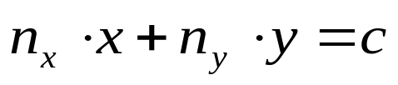
Implicit Equation of a Line
Line equation:
Alternative notation
n

Slide 25
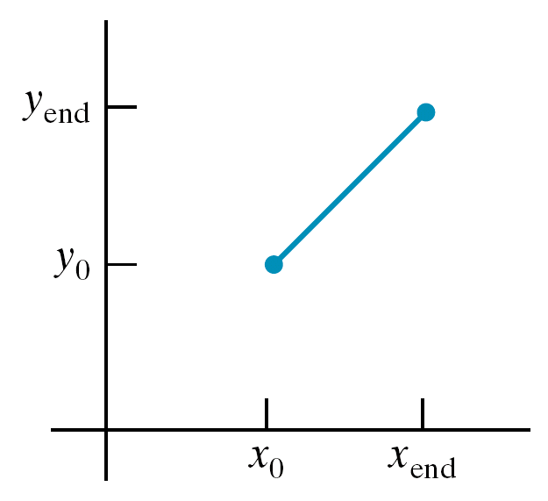
Slope Intercept Line Equation
line equation: y = m*x + b
line path between two points:
y_{end} − y₀
m =
x_{end} − x₀
b = y₀ − m.x₀

Slide 26
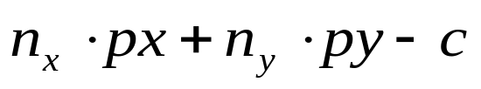
Distance between a point and a line
Use the line equation:
Divide the line equation by the length of n
Compute the absolute value of:
p
n

Slide 27
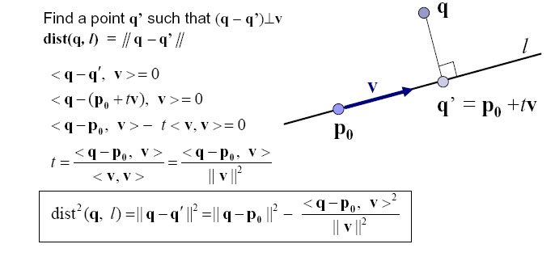
Derivation

Slide 28
Matrices

Slide 29
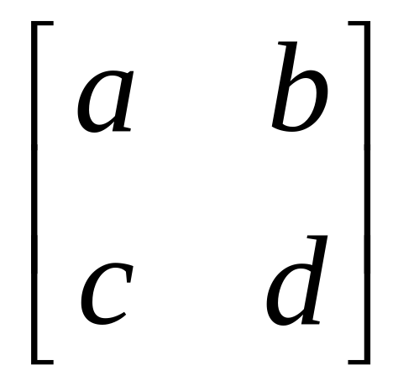
Matrix
A matrix is a set of elements, organized into rows and columns
rows
columns

Slide 30
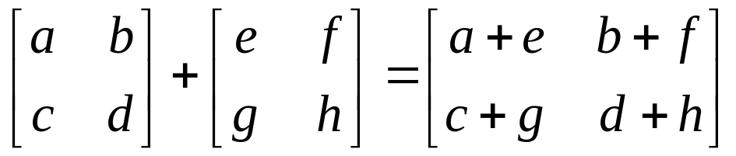
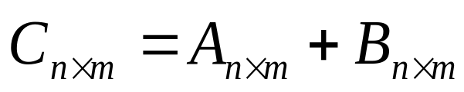
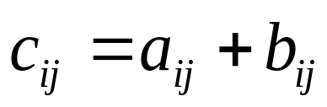
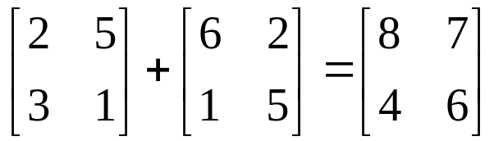
Matrix Addition
Addition
General Form
Example

Slide 31
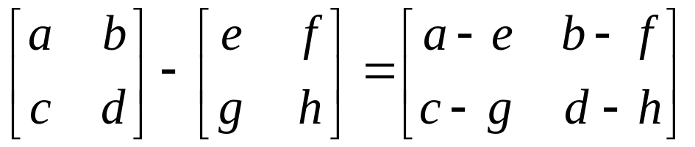
Matrix Subtraction
Subtraction

Slide 32
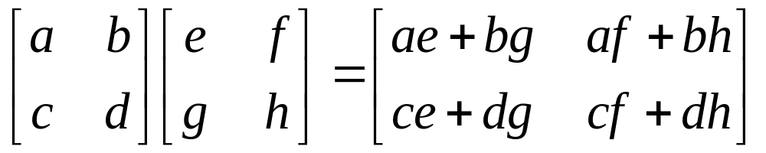
Matrix Multiplication
Multiplication
Multiply each row by each column

Slide 33
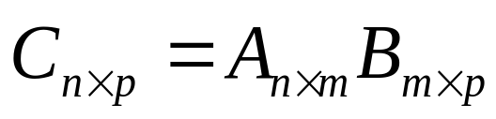
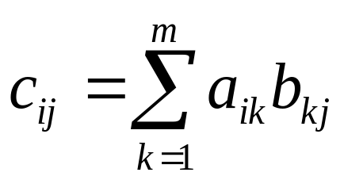
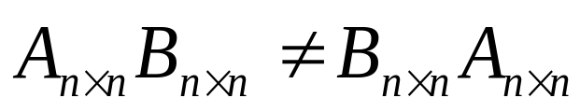
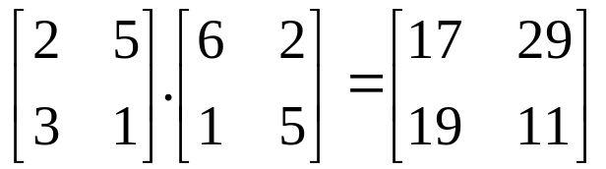
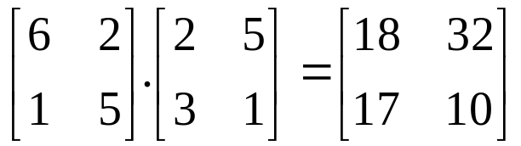
Matrix Multiplication
Multiplication:
A and B must have compatible dimensions
Examples:

Slide 34
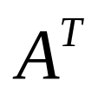
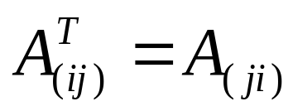
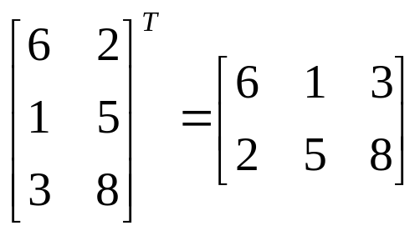
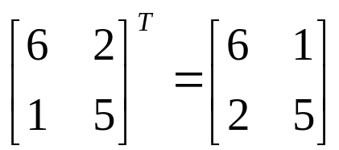
Transpose
Notation:
Definition:
Examples:

Slide 35
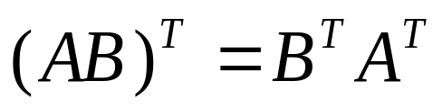
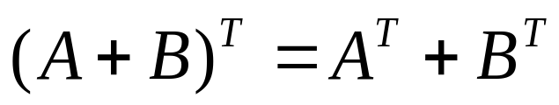
Rules

Slide 36
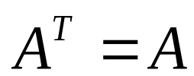
Symmetric Matrices
A is symmetric iff

Slide 37
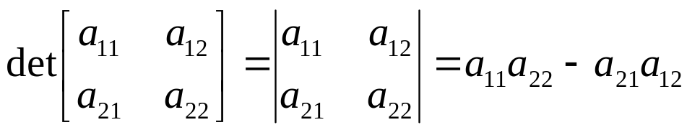
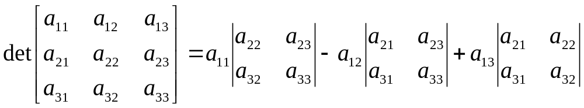
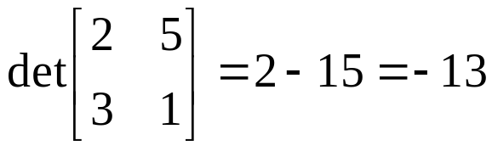
Determinants
Determinant (Note A must be square)
Example
:

Slide 38
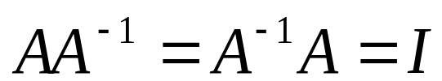
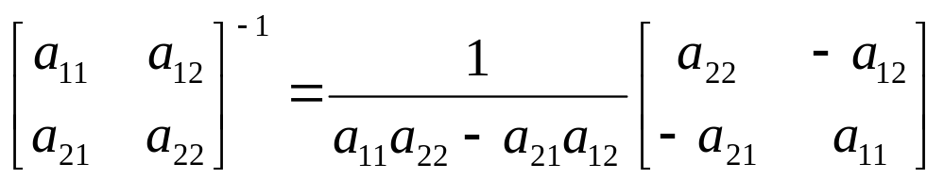
Inverse Matrices
Notation
I is the Identity (1s on the diagonal, 0s elsewhere)
Inverse Computation:

Slide 39
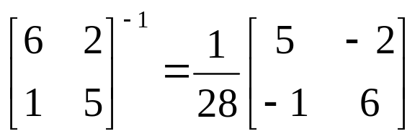
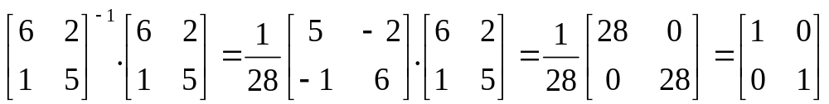
Matrices
Example

Slide 40
Combination of Linear Operators
Reflection
Orthoganal projection
Scaling factor
Shear factor
demo

Slide 41
Orthonormal Basis

Slide 42
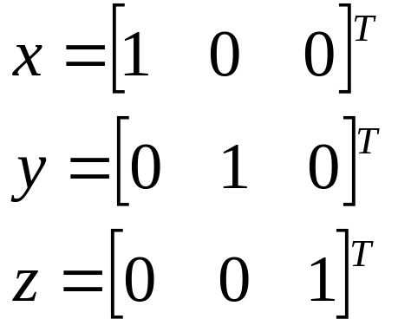
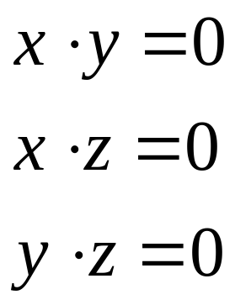
Orthonormal Basis
Basis: a space is totally defined by a set of vectors – any point is a linear combination of the basis
Ortho-normal: orthogonal + normal
Orthogonal: dot product is zero
Normal: magnitude is one
Example:

Slide 43


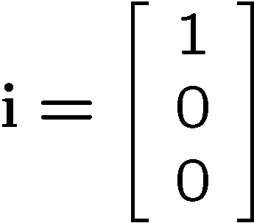
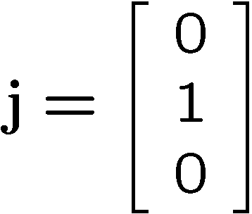
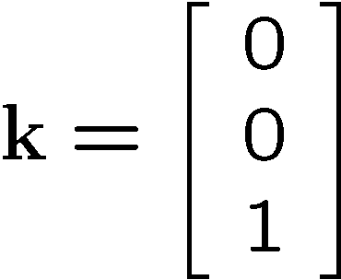





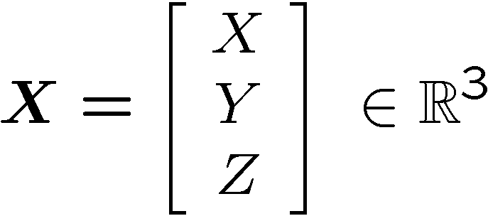

Orthonormal Coordinate in 3D
Standard basis vectors:
Coordinates of a point in space:

Slide 44

Change of Orthonormal Basis
How do we express any point as a combination of a new basis U, V, N, given X, Y, Z?
v
y
x
p
Given:
  coordinate frames
  xyz and uvn
  point p = (px, py, pz)
Find:
  p = (pu, pv, pn)
v
u
u
y
x
y
v
p
u
n
x
z

Slide 45
Change of Orthonormal Basis
pu
pv
pn
ux
vx
nx
uy
vy
ny
uz
vz
nz
px
py
pz
px
py
pz
=
= M
  What's M⁻¹, the inverse?
px
py
pz
xu
yu
zu
xv
yv
zv
xn
yn
zn
pu
pv
pn
ux = x . u = u . x = xu
=
M⁻¹ = M^{T}
Matrix A (n×n) is orthogonal if A⁻¹ = A^{T}

